Slide 1



Employee Data Analysis using Excel
STUDENT NAME : NATTAR DEVI .K
REGISTER NO DEPARTMENT COLLEGE
: 312215050
COMMERCE
SOKA IKEDA COLLEGE OF ARTS AND
SCIENCE FOR WOMEN

Slide 2


PROJECT TITLE
Employee Performance Analysis
using Excel

Slide 3



AGENDA
Problem Statement
Project Overview
End Users
Our Solution and Proposition
Dataset Description
Modelling Approach
Results and Discussion
Conclusion

Slide 4

PROBLEM STATEMENT
It is made for company Profitable grow
Employee personal growth too...
and success and also

Slide 5

ROJ CT OV RVIEW
Tke primary purpose of an employee data base is to store and organize employee related information for administrative , operational and analytical purposes

Slide 6

WHO ARE THE END USERS?
1. Company management I
2.Employee

Slide 7


OUR SOLUTION AND ITS VALUE PROPOSITION
Conditional formatting — missing Filter — remove
Formula — performance
Pivot — summary
Graph — data visualization

Slide 8


Dataset Descr pt on
Employee=—Kaggle 26—features 9—features
Emp id — number
Name—text
Emp type Performance level Gender— male female Employee rating—num

Slide 9




TH "WOW" I
SOLUTION
Performance level=IFS(Z8>=5,” RY
HIGH”,Z8>=4,”HIGH”,Z8>=3,”MED”,TRUE,”LOW”

Slide 10

MODELLING
Dataset:Kaggle,Employeedataset
Data Cleaning : Missing Values , Irrelevant
Formulae : Performance Calculation , Low , Medium , High
Pivot Table: Summary, Business Unit,Gender , Employment Type , Employee ID , Performance
Chart: Report

Slide 11
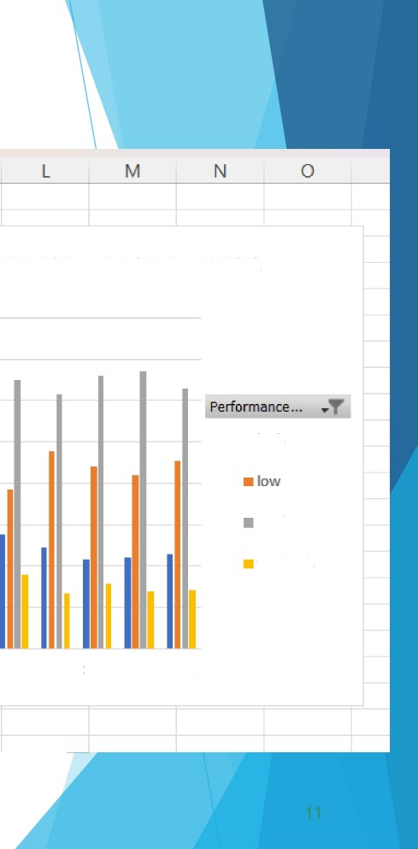

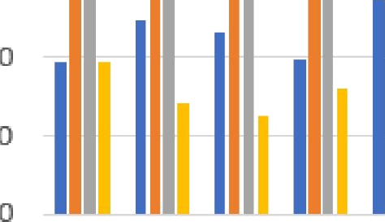
RESULT
A
°nderCode (AII)
B
E G
K
im of EmplD Column Labels •+
›w Labels high
GenderCode
EMPLOYEE PERFORMANCE ANALYSIS
low
med
veryhigh Grand Total
Sum of EmpID
400000
*C | 97746 | 223971 | 333324 | 97720 | 752761
PDR | 123871 | 249421 | 300372 | 71149 | 744813
 | 116188 | 214606 | 334567 | 62330 | 727691
SC | 98493 | 208809 | 337334 | 80271 | 724907
EL | 137017 | 210365 | 338138 | 61517 | 747D37
 | 138272 | 192708 | 324938 | 89780 | 745698
’Z | 122705 | 238682 | 307053 | 66355 | 734795
’G | 107827 | 220006 | 330629 | 78604 | 737066
JS | 109926 | 209942 | 335262 | 69464 | 724594
BL | 114701 | 227425 | 314076 | 70861 | 727 63
'and Total | 1165745 | 2195935 | 3255693 | 748051 | 7356425
3 SOOOO
3 DDOD0
25D0D0
w high
2DD0D0
150000
need
l00DD
veryhigh
50000
BusinessUnit
""" DCDR E'A* MSC NEL PL PYZ SVG TNS WBL

Slide 12

1. Highlight key findings from the data.
2. Making generalized comparisonsAssess the right strength of the claim.
5. Are hypotheses supported? To what extent? To what extent do generalizations hold

